Slide 1

Capstone Project:
Consumer Decision-Making
When
Feeling Out-of-Control
By Vincent, Elizabeth and Carla
Notes:
Page 1 vs. page 2 vs. page 3

Slide 2

Agenda
RPA
Research Context
Research Question
Data Sources
Methodology
Business Implications
Project Plan
Notes:
Script:
Here is the…
First, let’s introduce RPA
Transiton to next page

Slide 3

RPA Overview
Notes:
Give a visulization here
Big milestone page: have a image

Slide 4
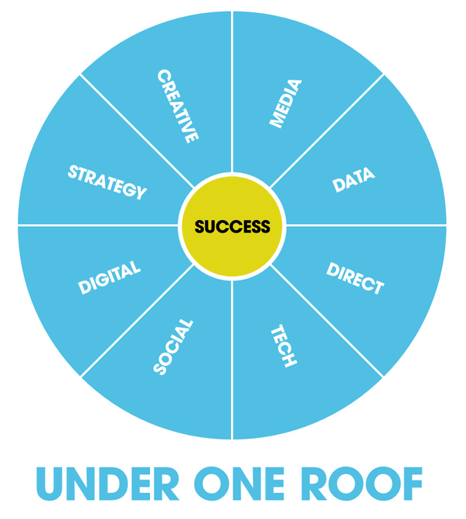
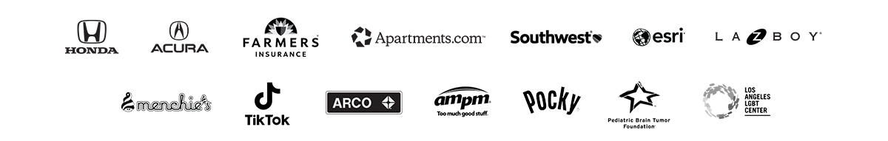
RPA
RPA is a leading independent, full-service marketing agency focused on:
People first.
Long-lasting relationships built on trust.
Results by growing client’s profit margins.
Notes:
They are leading company because of their innovative fundamental research.
Punchline words: success ← good reserach, here are the examples

Slide 5

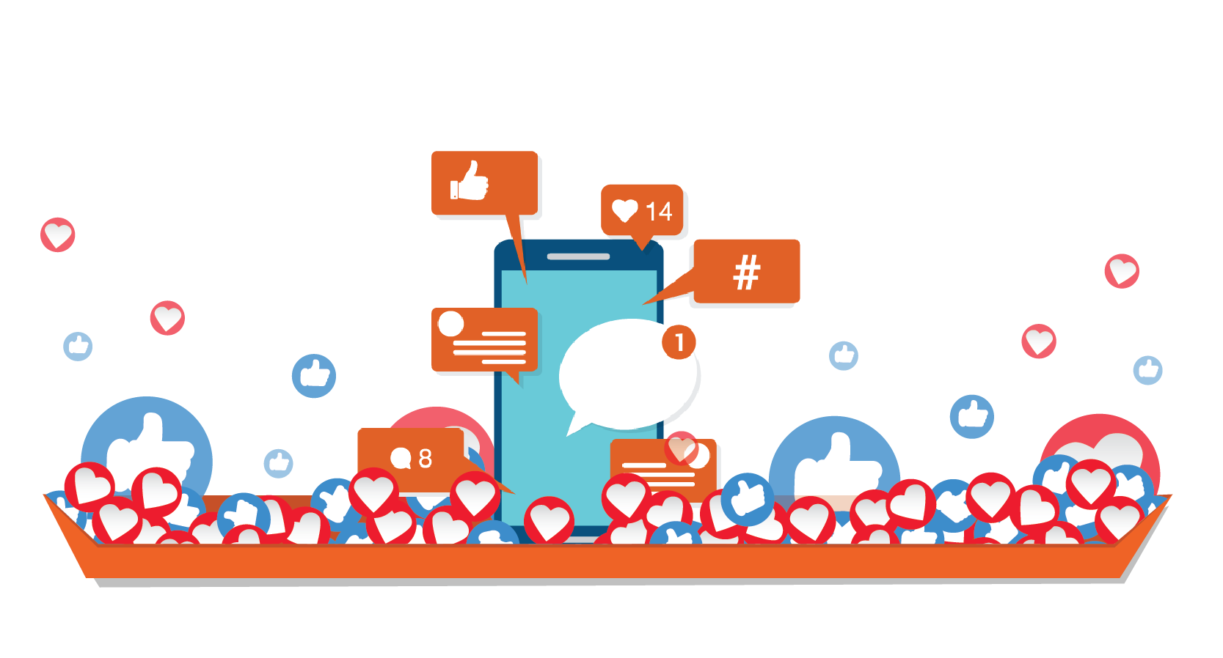
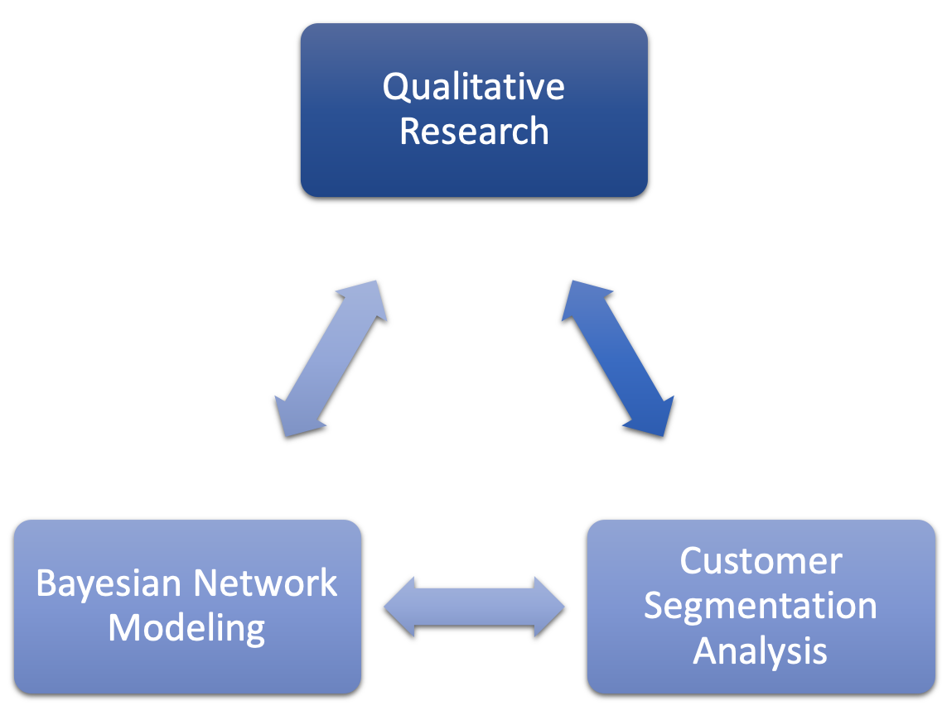

RPA
Brand Awareness
Sales
Notes:
As we said, RPA is people first and expert in study con decisoin journey, like here for the state farm qulaity quantity baysain → insigh on segment
Which educat → good results
Segmentation, attribution model
Farms insurance: converstion rate/consideration, tracking data, bayesian model,
People first
Farmers Insurance
In response to the noisy insurance category, RPA used a custom segmentation analysis, Bayesian network modeling and qualitative research to help Farmers Insurance break through. Insights drawn from this research built a campaign that focused on the company's experience, particularly with outrageous situations, which increased awareness, drove differentiated attribute growth, grew consideration and drove record purchase of new policies.

Slide 6

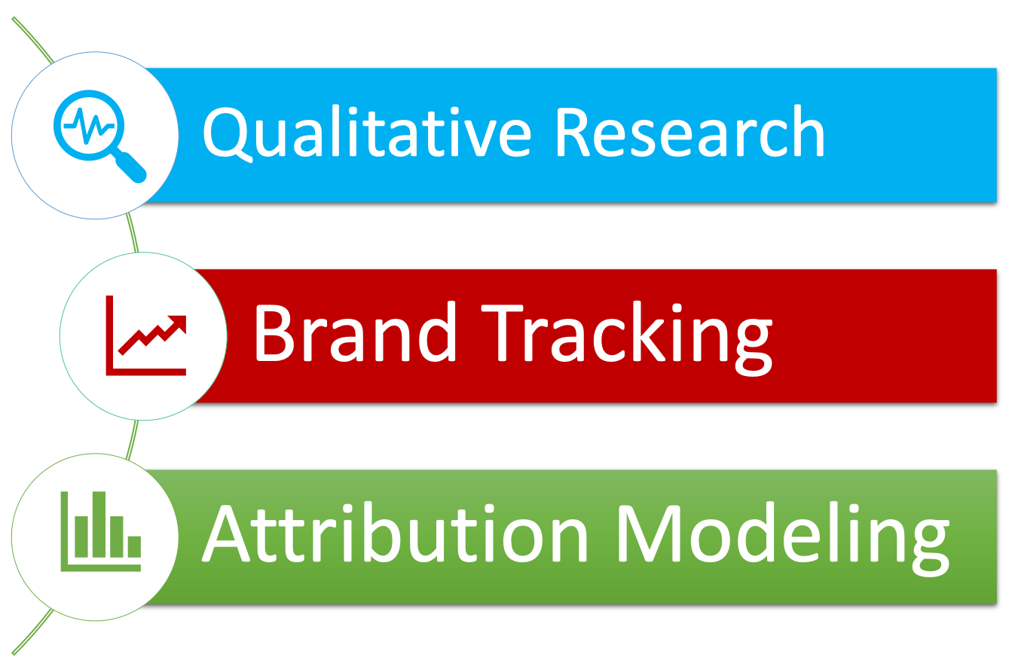
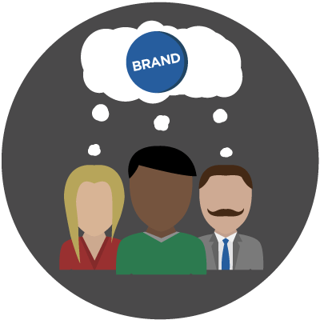

RPA
Notes:
Icon: apprtments logo
Similaryly here, rpa qualt this time they use b trackign
Summary:
Apartments.com
After CoStar Group purchased Apartments.com, RPA built the brand using an integrated strategy that combined business, content and media strategy with qualitative research, brand tracking and attribution modeling. By identifying target groups using qualitative and quantitative analysis of syndicated and custom research, RPA applied these learnings to digital creative, offline media and TV buying. In the first year, all these efforts led to an increase in site visits, unaided awareness, unaided intention and savings.

Slide 7
Research Context
Notes:
image

Slide 8
Context
How do consumers make decisions when they
feeling out-of-control?
Our Research Focus
Notes:
Describe Current Situation: coronavirus info
Impacting everyone/ all aspects of society
How do consumers make decisions when they feel out of control?

Slide 9

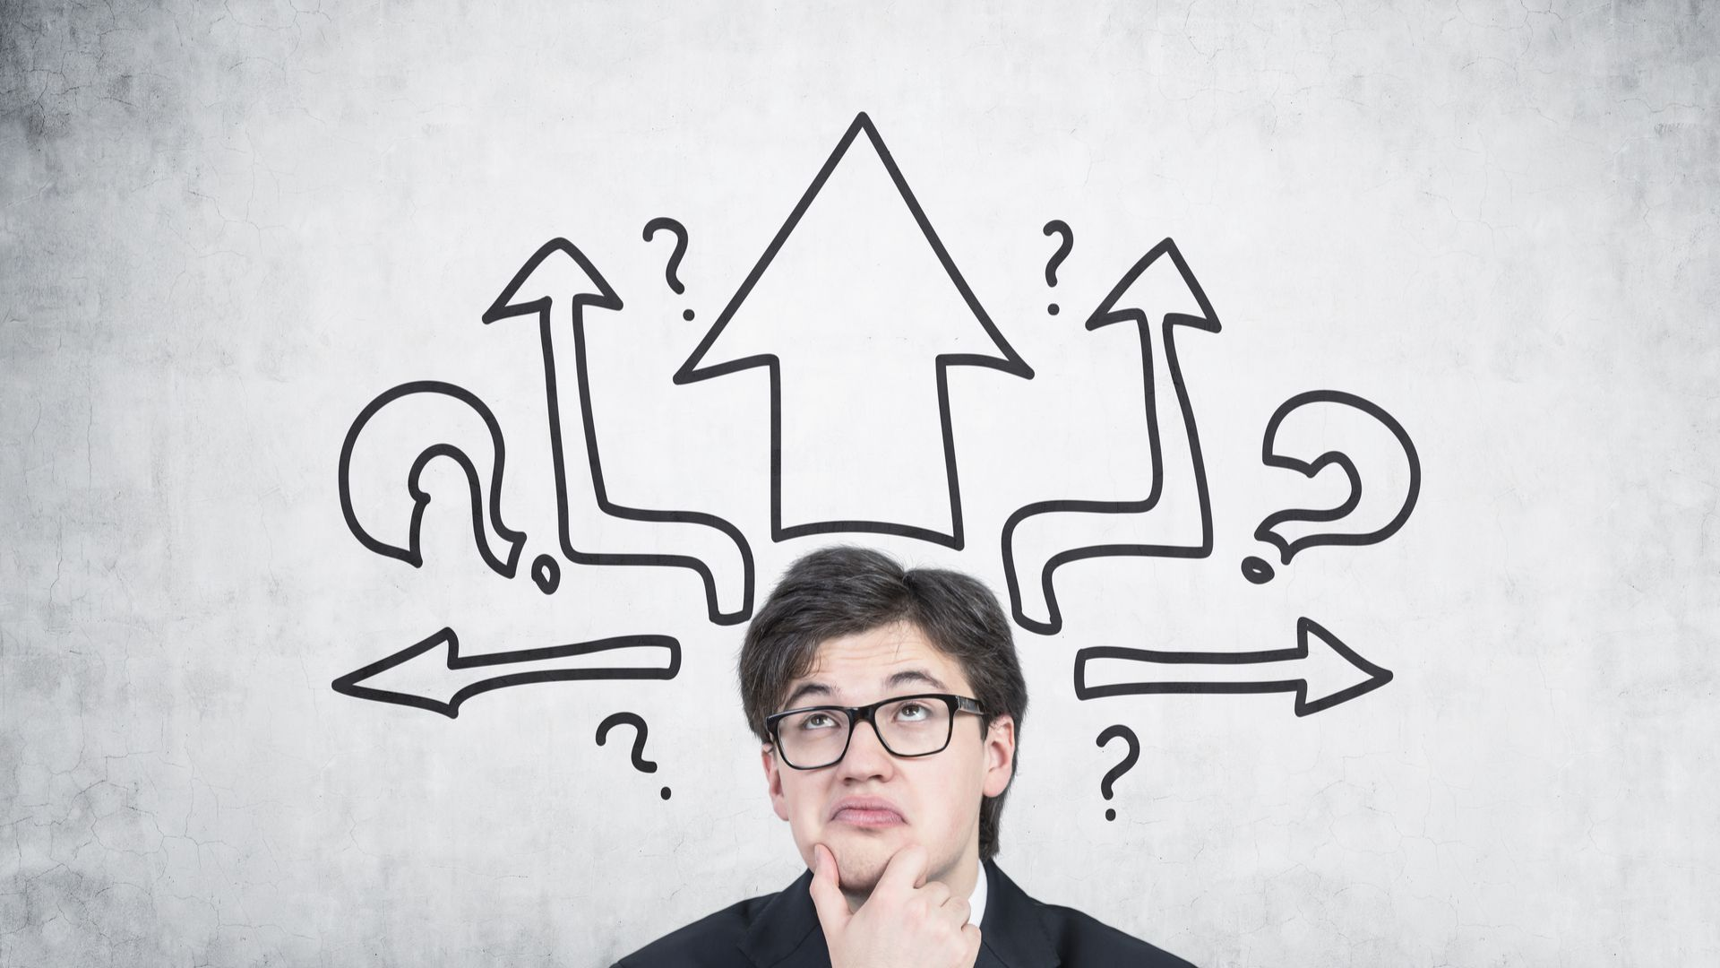
Why Consumer Decision-Making?
Context
Why Out-of-Control?
Notes:
Re-iterate the Two keywods:

Slide 10
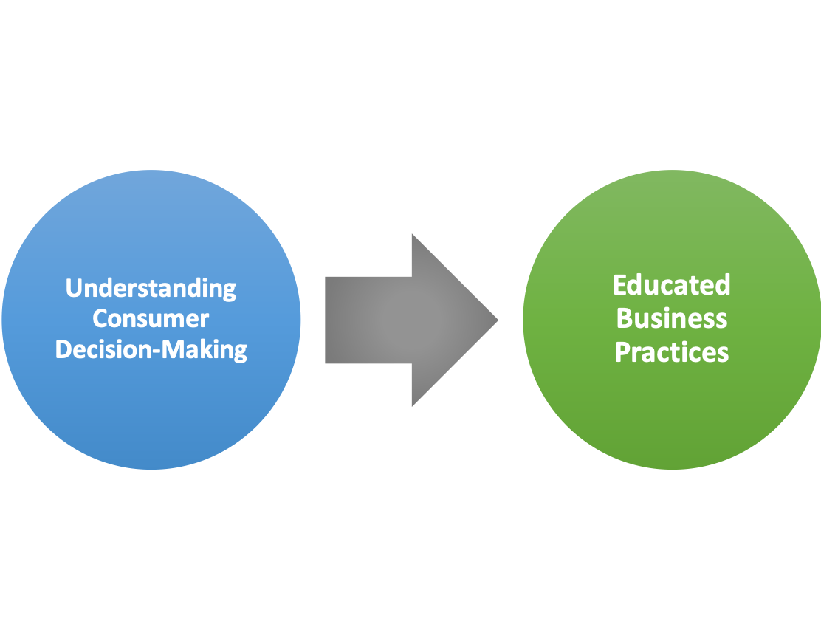

Context
Why Consumer Decision-Making?
Notes:
Relative obvious
As we see in RPA’e example:
Good reserch → good busoniess preactice
You may already answered that question once you talked about the RPA’s research example
Predict behavior and influence decision-making
Align marketing efforts with the steps customers undertake to decide what to buy
Understand external factors that are influencing
decision-making

Slide 11
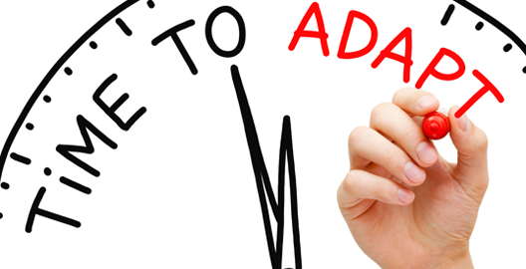
Why Out-of-Control?
Context
We are now in the situation of out-of-control that businesses need to adapt to.
Notes:
Why out-of-control

Slide 12
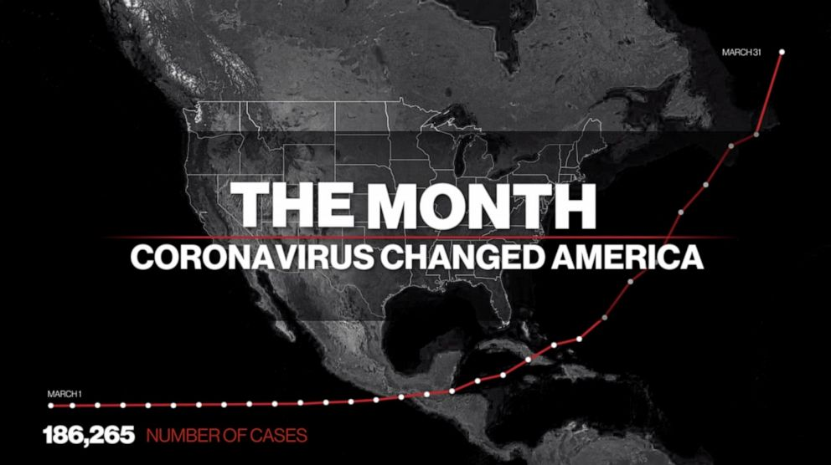
$4.1 trillion loss (ADB)
100% recession (Bloomberg)
Notes:
S&P 500 shows largest quarterly decline since 2008 and Dow has worst first quarter in history.
We need to adapt to the out-of-control situation!!!
Consumers feel out of control, and businesses are panicking.

Slide 13
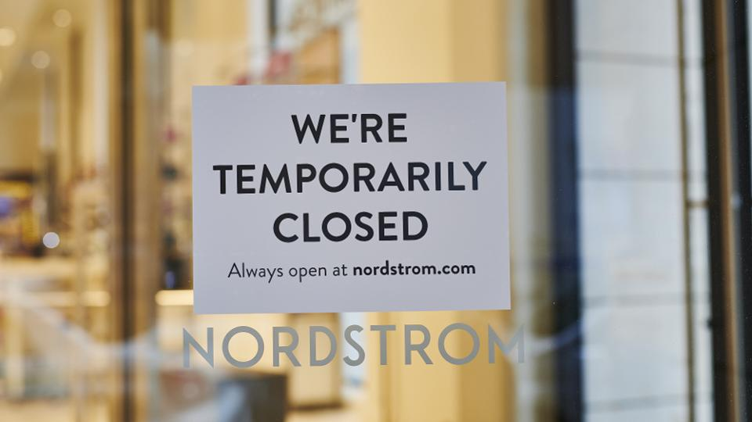
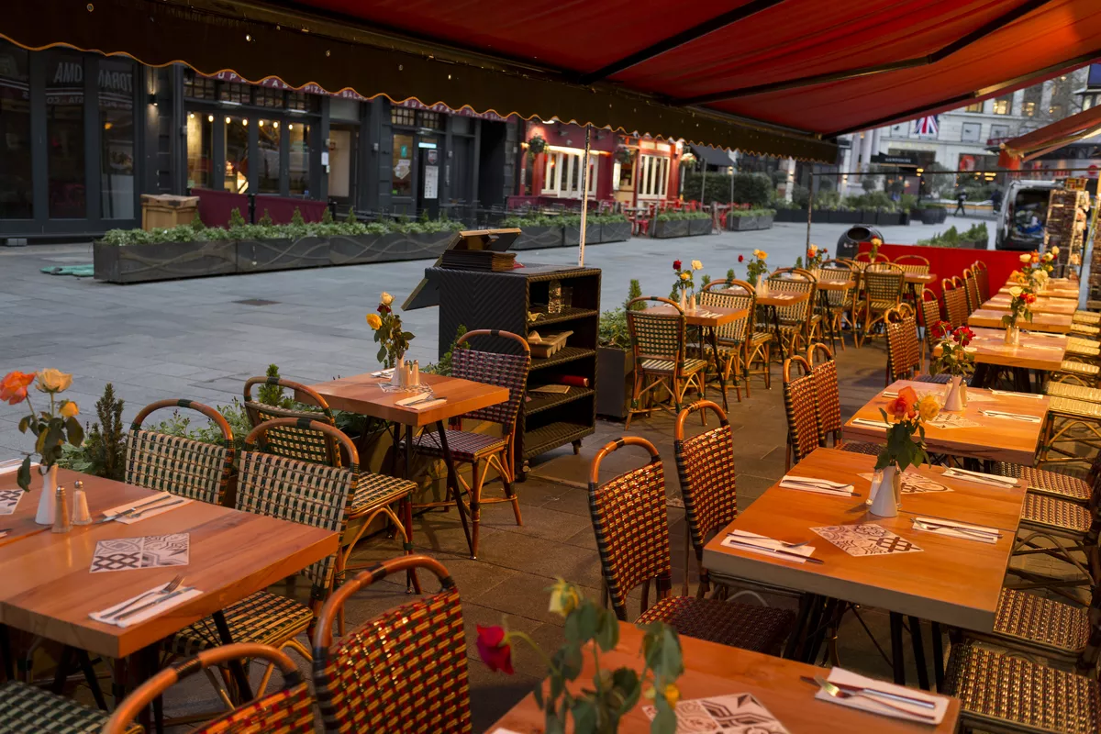

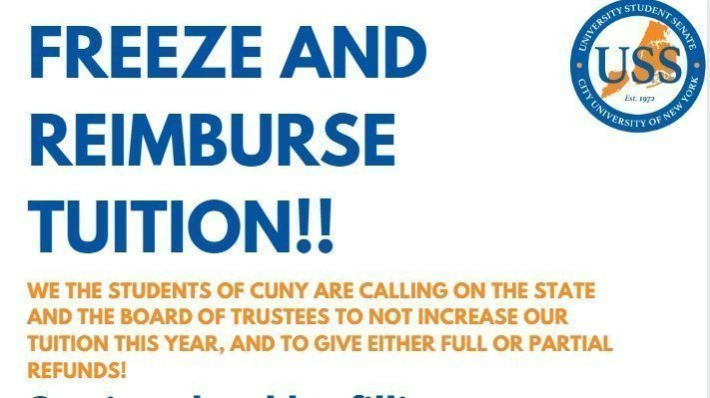
Context
Industries Affected...
Notes:
summary/transition : we are in out of control sitatuation to which businesses are struggling to adap to
That’s why we need to

Slide 14
Context
COVID-19 Predicted Impact
DISTANCE
CONTACT-FREE ECONOMY
RESILIENCY
Technology
Supply Chain
Preparation
Reduce Operating Costs
Digital Commerce
Telemedicine
Automation
BUSINESS SCRUTINY
CONSUMER ATTITUDES
CONSUMER
BEHAVIORS
CSR
Triple Bottom Line Intensified
Physical Distance
Health
Privacy
Financial Security
Reduced Spending
Pattern Shift
Notes:
Increased Purchases
Grocery
Home-based Entertainment
Electronics
Entertainment Streaming
eSports
Household Supplies
Personal Care Items
Restaurant and Grocery Delivery
Online Education
Online Fitness
Delayed Purchases (43%)
Cars
Houses
Luxury Goods
Reduced Spending (44%)
Travel
Out-of-Home Entertainment
Apparel and Footwear
Home Furnishings
54% no longer considering big ticket items: houses, cars, trips, luxury goods
Agility PR: “asked consumers which brands they trust most to get them through the crisis”

Slide 15

Why Out-of-Control?
Context
Consumers are feeling
out of control.
Notes:
Why out-of-control

Slide 16
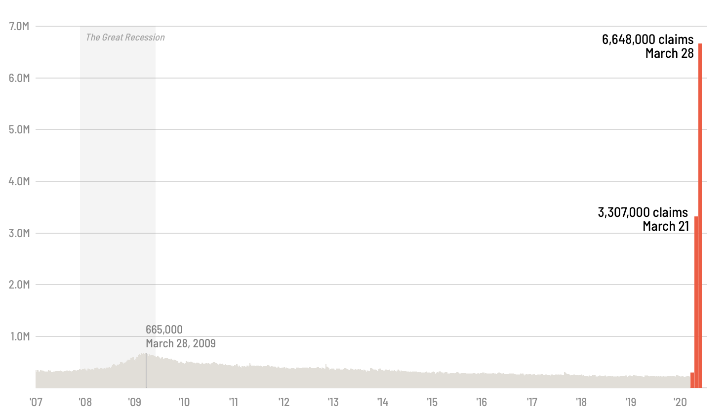
Context
Consumers Feel Out-of-Control
7 out of 10 income affected
700K+ jobs cut
22 million filed for unemployment
Notes:
income→ buget → consumption/consumption behavor
Unemployment → income → consumption behavior/decision making (→ social proof)
A long queue waiting outside of groceries stores (recall your feeling when you are in the queue).

Slide 17
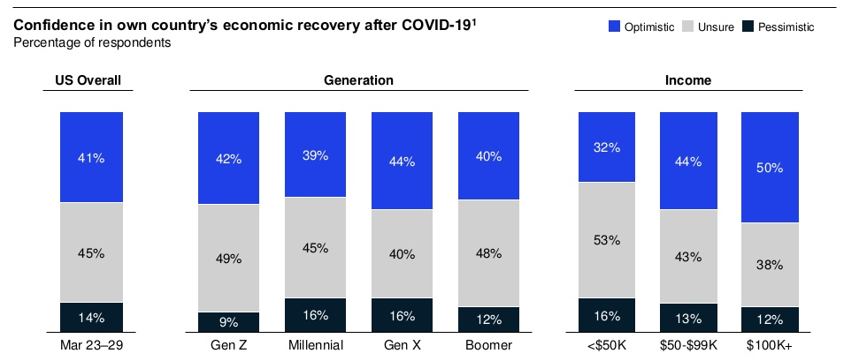
Context
Uncertainty of US Population
McKinsey Consumer Sentiment Survey 2020
Notes:
Brief:
Limited bugdet also inlfuence consuemr’s perspective for future, as we can tell the gray part the the percent of cnosumers who feel pessimitic about the future econmy.
I would in general consumers’ already felt the adverse impact.
Optimistic: economy rebound in 2-3 months
Unsure: impact last 6-12 months, slow growth after
Pessimistic: lengthy recession
Gen Z is least pessimistic; higher income have higher optimism

Slide 18
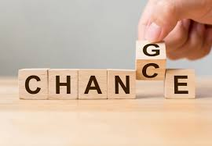
Why Out-of-Control?
Context
Consumer behaviors
have already changed.
Notes:
Why out-of-control

Slide 19
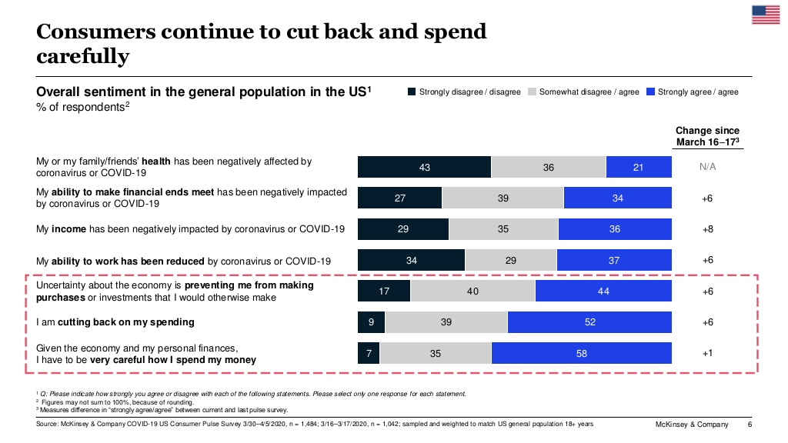
McKinsey Consumer Sentiment Survey 2020
Notes:
Original report
https://www.mckinsey.com/business-functions/marketing-and-sales/our-insights/survey-us-consumer-sentiment-during-the-coronavirus-crisis
Slides clipped here
https://www.slideshare.net/McK_CMSOForum/mckinsey-survey-us-consumer-sentiment-during-the-coronavirus-crisis-231658851?ref=https://www.mckinsey.com/business-functions/marketing-and-sales/our-insights/survey-us-consumer-sentiment-during-the-coronavirus-crisis

Slide 20
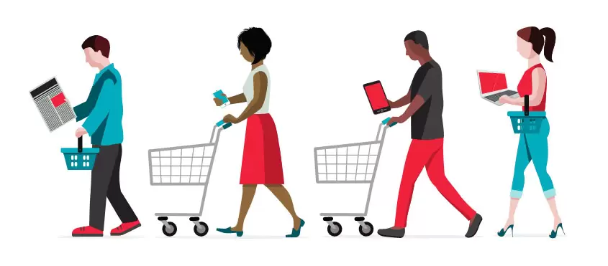
Context
Consumption Pattern Shift
Reduced Spending (44%)
Travel
Out-of-Home Entertainment
Apparel and Footwear
Home Furnishings
Increased Purchases
Grocery
Home-based Entertainment
Electronics
Entertainment Streaming
eSports
Household Supplies
Personal Care Items
Restaurant and Grocery Delivery
Online Education
Online Fitness
Delayed Purchases (43%)
Cars
Houses
Luxury Goods
McKinsey Consumer Sentiment Survey 2020
Notes:
54% no longer considering big ticket items: houses, cars, trips, luxury goods
But this is only descriptive documentary, not touching to the decision process yet.

Slide 21

Research Question

Slide 22
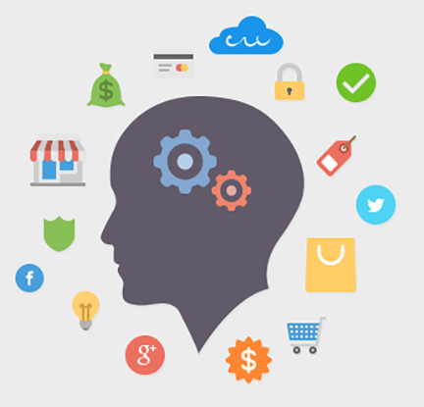
Question
Social Proof and Decision-Making
Social Proof: people mirror the actions of others in order to reflect the appropriate behavior.
Robert Cialdini, The Psychology of Persuasion:
“When we are uncertain, we are willing to place an enormous amount of trust in the collective knowledge of the crowd.” (p.131)
“Social proof is most powerful for those who feel unfamiliar or unsure in a specific situation.” (p.129)

Slide 23

Question
How are current uncertainties impacting the tendency for people to rely on social proof?
Hypothesis: The more uncertain people feel, the more they will more rely on social proof.
Notes:
Social Proof → others?
Strangers vs close others (support network)

Slide 24
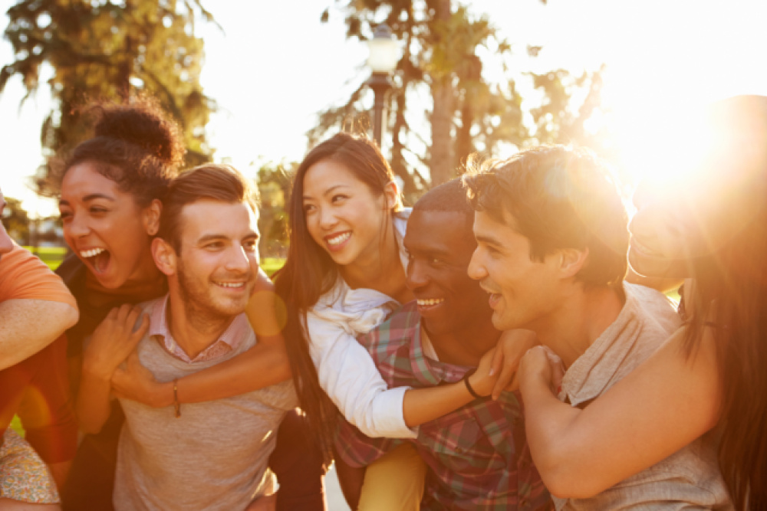
Question
Relationships Impact Decision-Making
Who are people turning to for guidance?
“Strangers” vs. “Social Circle”
Craving Information
In-group Identity
Notes:
Social proof is basically rely on other, but who are those others.
Exploratory
Stay home - influenced by friends/family
Hillary mentioned in the meeting that when people feel uncertainty, their in-group identity will more salient, thus they might be rely more on close relationships. (again, if you are not comfortable talking about identity, you don’t have to. ----Richard )
Hogg 2000: State of uncertainty - most people act to reduce uncertainty: provide a sense of belonging - provides prescriptive norms/guidelines for appropriate behavior
Crave information - seek advice from strangers
Potential Moderators: Importance/Type of Purchase

Slide 25
Question
Social Proof
Relationships
The more uncertain people feel, the more they will more rely on social proof.
“Strangers” vs “Social Circle”
Notes:
Social proof→ others?
Summary page
Logic flow and process

Slide 26
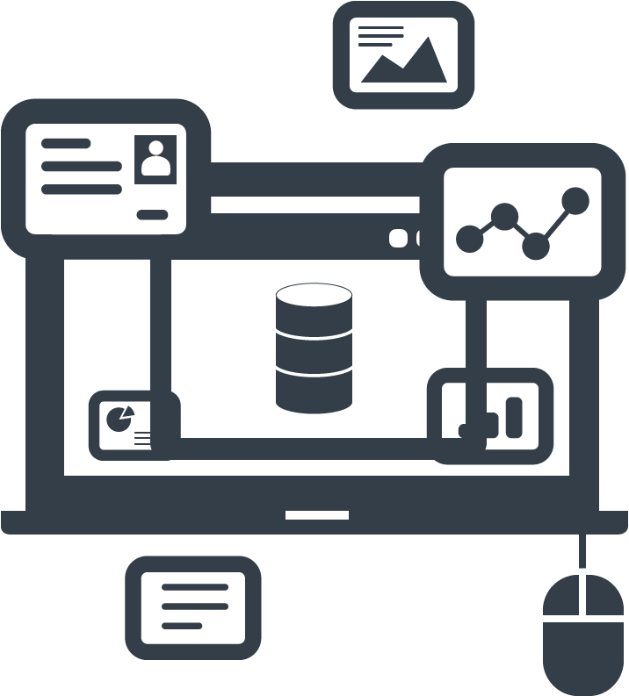
Data Sources
Notes:
Before we jump into the Data sources, we have to ask ourselves a question: What are the data like that we need for this research?

Slide 27
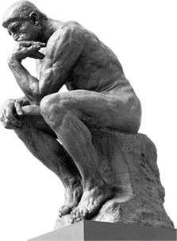
Sources
Identifying the Data
The data should:
Purchase/ money related
Include consumers' opinions/comments
Longitudinal
Notes:
In our opinion, the data that is worth investigating, should at least fit three characteristics.
First, the data should be purchase or money related, this is defined by our research question;
Secondly, the data should include consumers’ opinions or comments, which could reflect the psychology or decision making process of consumers; It could also give us the opportunity to operationalize some measures of “social proof”
Last but not least, the data should be longitudinal to some extent, so that we could compare the change in data before and during the pandemic

Slide 28
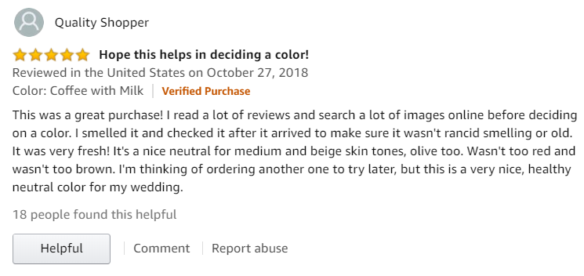
Sources
Data Sources for Decision-making Process
Source: Yelp reviews, eBay reviews, Amazon reviews, etc.
Notes:
Following these thoughts, we can operationalize different sorts of data.
First we would operationalize the data of decision-making, possible sources include the reviews from Yelp, eBay and Amazon.
Now let’s focus on this specific Amazon review. This shopper leads with “this was a great purchase”, which implies some positive emotion expressed by this customer. Then she said, “I read a lot of reviews and search a lot of images online ”, that is exactly what consumers might do before making a purchase. By analyzing all the similar reviews like this, we would be able to measure the tendency of social proof in consumer’s decision-making process.
Data Sources for Decision-Making

Slide 29
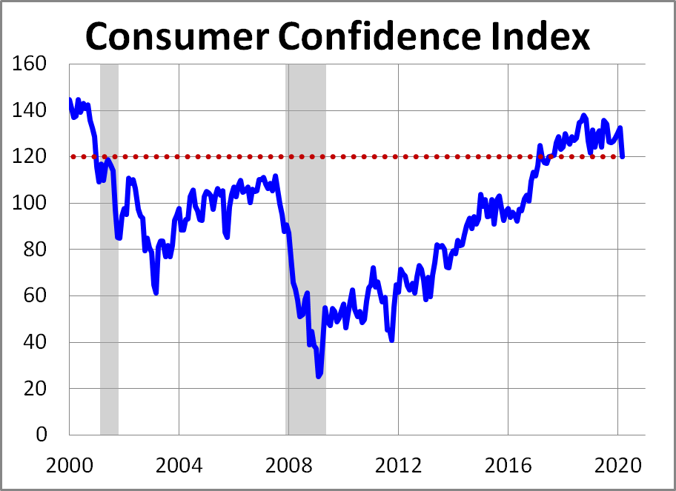
Sources
Data Sources for “Out-Of-Control” Status
Source: Consumer Confidence Index, S&P 500, Dow Jones Industrial Average, etc.
Notes:
Secondly, the data from out-of-control, which should show the economic uncertainty.
Possible sources include consumer confidence index, S&P 500, Dow Jones Industrial Average, etc.
This is a chart for the consumer confidence index from year 2000. We can see that we have a great fall during the 911 and the 2008 financial crisis. With the changes in this index and the time data, we could run the time series analysis.

Slide 30
Methodology
!
Notes:
Now we know what our input data looks like, it is time to talk about what could we do with these data, it will be very interesting.

Slide 31
Methods
Methodological Approach
Word Embedding
Convolutional Neural Network
Time Series Analysis
Raw Textual Data
Numerical Representation
Quantified Attributes
Findings
Method
Data / Metrics
Notes:
Since our main data would be from the reviews, or say texts, for the convenience of analysis, we need to convert them into numbers with word embedding. Then we can apply the CNN, convolutional neural network to get our quantified attributes, which includes social proof. Finally we would use time series analysis to reach our final findings. In our presentation, we are going to focus on the Word embedding and the CNN part.

Slide 32
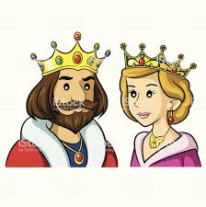
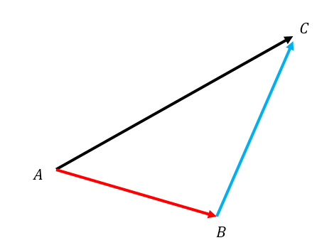
Methods
Word Embedding
Assigning ID to words
Hundreds to even thousands digits
Making words vectors
Doing algebra with words
Notes:
Word embedding, is basically to assign an ID to each word. The length of the ID could vary from hundreds to even thousands of digits. Currently, the main purpose of word embedding to make the words like vectors, so that we could do algebra with these words.

Slide 33
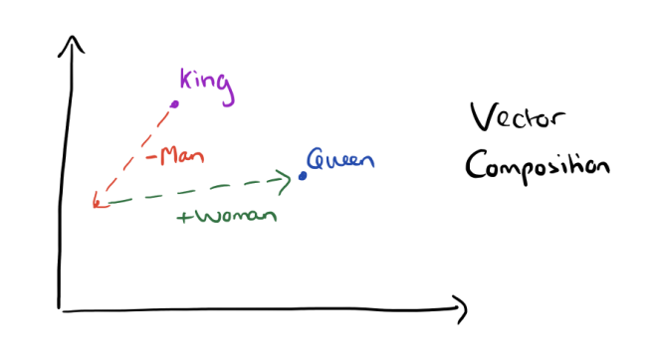

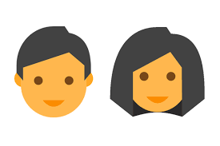


Methods
Word Embedding
Royal
Notes:
Here is a famous example in word vectors. First we start from the point of king here, we remove the meaning of man from king and follow this red arrow to the left point, which would probably mean royal. Then we add the meaning of woman to the point of royal to follow the green arrow, we could finally reach the point of queen. Descending like an angel.
Isn’t that just magic? We just use several words to finish the transition from king to queen. That is how word vectors work.

Slide 34




Methods
Word Embedding Equations
King - Man + Woman = Queen
U.S. - Washington + Roma = Italy
Small - Smaller = Large - Larger
…....
Notes:
Here are some more word vectors examples shown in equations. The first one, as we have illustrated, is king minus man plus woman equals to queen. Second, US minus Washington plus Roma equals to Italy. Then Small minus smaller equals to large minus larger. There are many more examples that we can see in the world of word vectors.

Slide 35
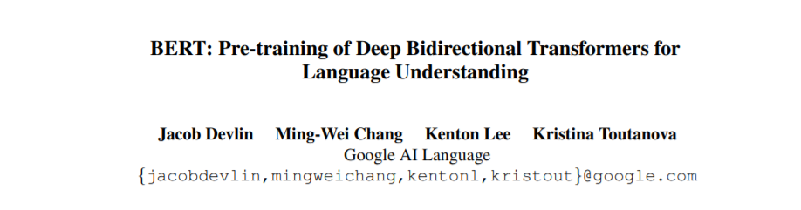
Methods
Word Embedding with BERT
Bidirectional Encoder Representations from Transformers (Devlin et al., 2018)
Notes:
After introducing the word embedding, we are going to explore the beauty in BERT. The full name of BERT is Bidirectional Encoder Representations from Transformers. It is a cutting edge word embedding technology, published by Jacob Devlin and other researchers from Google in 2018.

Slide 36
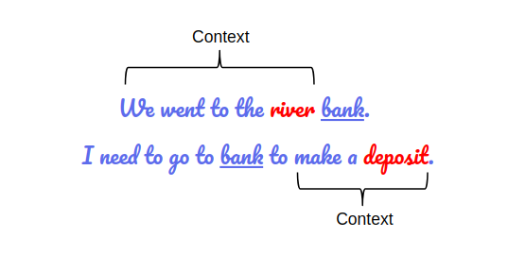
Methods
Why BERT?
Trained on billions of words
Transferrable
Encode contextual information
Better comprehension
Notes:
There are also a lot of convenient word embedding methods like Word2Vec, but why do we use BERT?
Firstly BERT has been trained with billions of words from wekipedia so it is very mature and transferrable.
Secondly, BERT could encode the contextual information.
Let’s take a look at the two sentences in the right. First one read “we went to the river bank”, second one read “I need to go to the bank to make a deposit”. The word “bank” is in both sentences but has different meanings. Many word embedding systems can only encode one meaning for each word. However, BERT could generate different meanings for each word based on the context. In the first sentence, BERT could notice the context of “we went to the river” so the meaning of bank would be closer to the river; In the second sentence, BERT could notice the context of “make a deposit” so the meaning of the bank would be closer to the deposit. That’s the beauty of BERT.

Slide 37
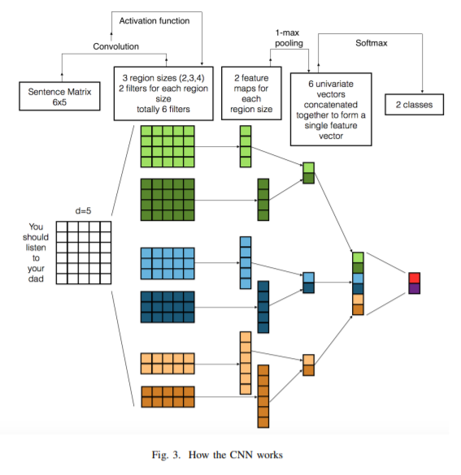
Methods
CNN on NLP Tasks
Word Embeddings
Feature Engineering
Pooling
Prediction
General sentiments
Polarities (Positive --- Negative)
Subjectivity (Subjective -- Objective)
Customized attributes
E.g., “social proof”, “strangers”, “social circle”
Notes:
After the word embedding process with BERT, We are going to perform some NLP tasks, which means Natural Language Processing. We are going to use CNN, convolutional neural network to complete our NLP tasks.
Let’s directly look at the very left of the chart, we have a sentence read ”you should listen to your dad” with six words, each of them would be assigned an id so that we now have a matrix. With the filters in featuring engineering, we are able to generate six different regions, then we will concentrate each region into a vector. Then we would go with the pooling method to combine the vectors together. After several rounds of combination, we would finally generate a model vector, which we could use to generate our prediction.
With CNN we could generate different important attributes that we can study in: the polarities, which measures a review is being more positive or negative; subjectivity, which measures a review is being more subjective or objective; In addition, we could also generate more customized features as we want, like , “social proof” of a review, a measure of “strangers”, “social circle”, etc.

Slide 38
Methods
Why CNN?
Customized measures
E.g. “social proof”, “strangers”, “social circle”
Measurement validity
Captures out-of-vocabulary (OOV) characteristics
Notes:
There are several special advantages with CNN. Most importantly, CNN could generate some custom features that we want, for example, the measure of social proof. Another advantage is the measurement validity of CNN, it could capture the out-of-vocabulary characteristics to us.

Slide 39
Methods
Custom Features with CNN
“I heard this product from Kylie Jenner”
CNN is able to capture the embedded clues of social proof
Traditional dictionary-based approach failed
As “Kylie Jenner” is PROBABLY NOT in many pre-developed dictionaries for measuring sentiments
Notes:
Here is a typical sentence with social proof: “I heard this product from Kylie Jenner.”
In traditional dictionary-based approaches, “Kylie Jenner” is PROBABLY NOT in many pre-developed dictionaries for measuring sentiments. That is not we want. It is Kylie Jenner! We HAVE TO notice this name. A well trained CNN model can catch the behavior of “hear from”, in turn inferring the customer is seeking information somewhere and thus assign a score for social proof. Then the Kylie Jenner is also taken records within CNN.

Slide 40
Methods
Summary
BERT
CNN
Notes:
In summary, we are going to use BERT to deal with our word embedding, and then use CNN to generate custom attributes we want, like the score for social proof.
Next Elizabeth would talk about the business implications of our research.

Slide 41
Business Implications
Notes:
With the proposed data and methods, our research has the potential to shed more lights on consumer decision making in the era of out-of-control.

Slide 42

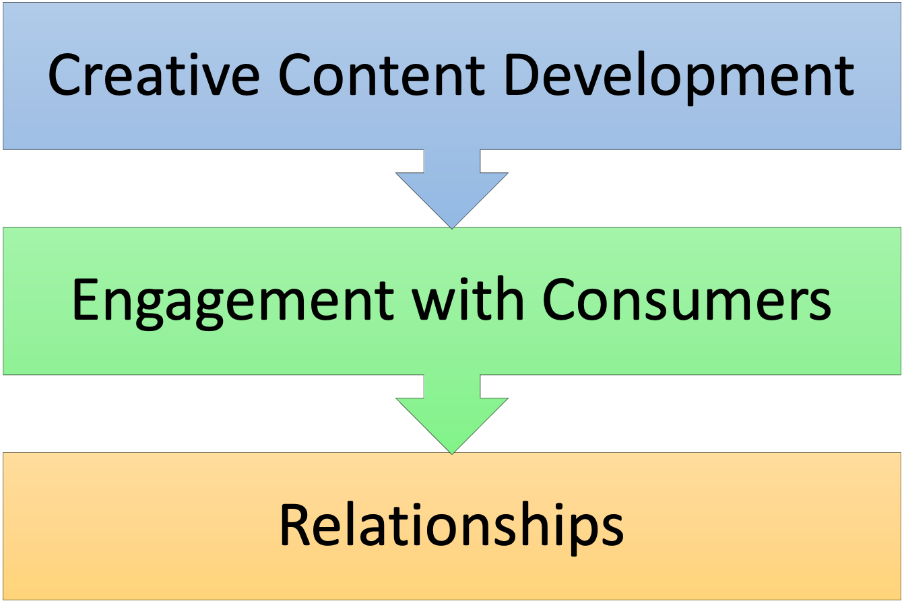

Implications
Notes:
Targeted marketing communication
E.g., give more clues on social proof in marketing communications when consumers feeling out-of-control
Businesses can learn how to connect and engage consumers in times of uncertainty
Influence decision-making process
Understand and better predict behavior
Identify identities of “social-proof” in uncertainty.

Slide 43
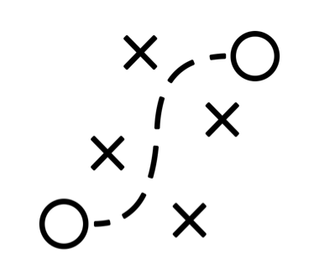
Project Plan

Slide 44
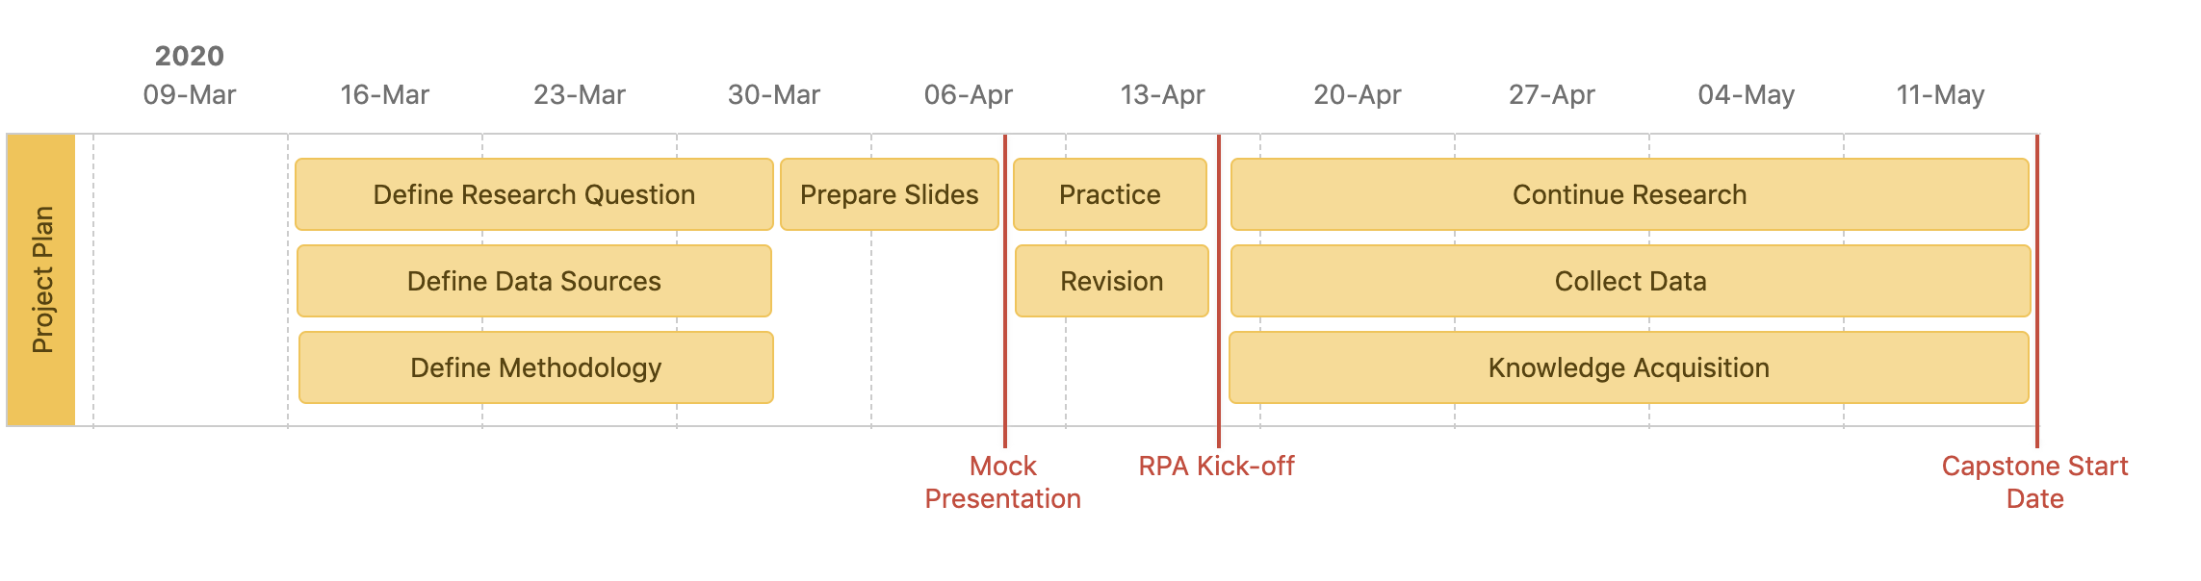
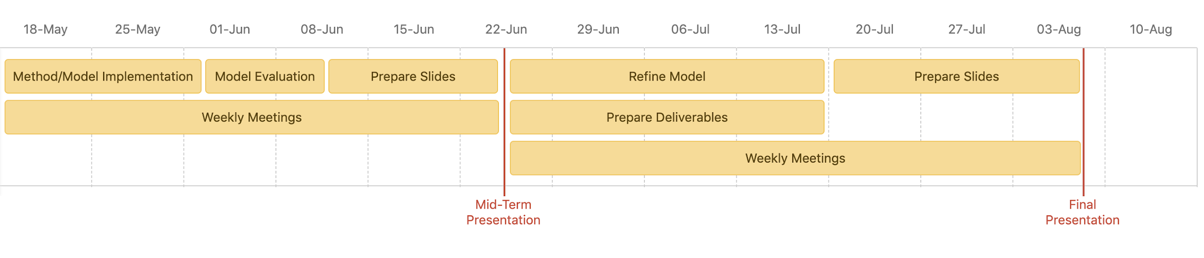

Slide 45

A special thanks to:
Dr. Hillary Haley, RPA
Divya Suri, RPA
Dr. Sijun Wang. LMU
MSBA faculty members, LMU
Team Members:
Carla Fera, Elizabeth Hyde, Vincent Chen
Advisor:
Dr. Zhen “Richard” Tang

Slide 46
Thank you!
Any questions?

